Slide 1
How to LEARN a NEW TECHNOLOGY
By
john Sylvester

Slide 2

Five Pillars of IT Industry :
Operating Systems
Networking
Database
Programming
Artificial Intelligence

Slide 3
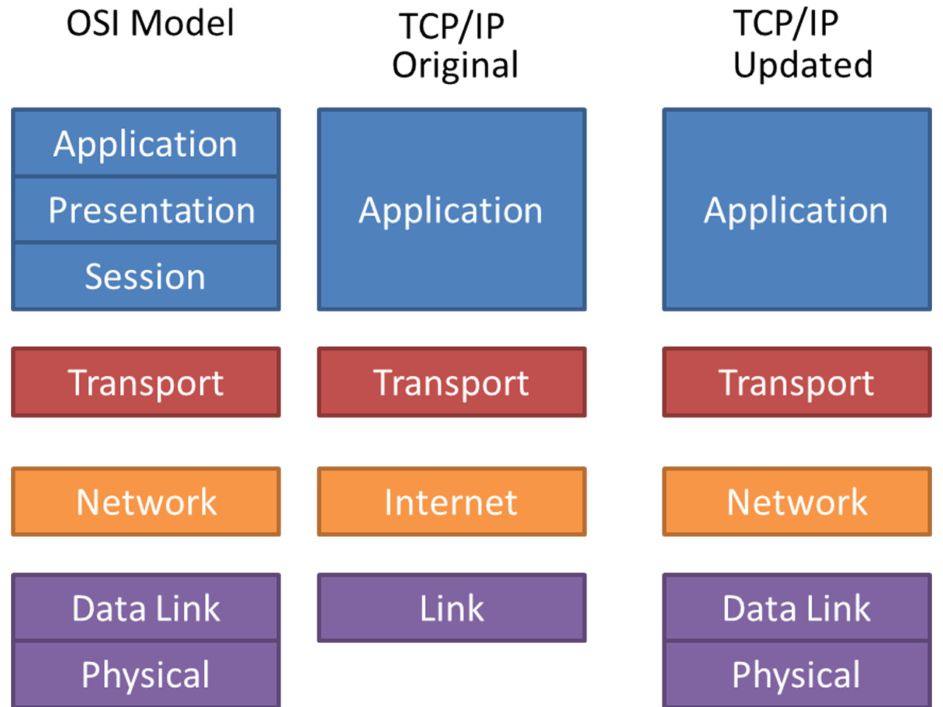
Five Pillars of IT Industry Contd …
Operating Systems
Concept of layering followed everywhere
Networking
Database
Programming
Artificial Intelligence

Slide 4
Five Pillars of IT Industry Contd …
Operating Systems
Cloud = OS
+
Networking
+
Database
+
Programming
AI = Mathematical
Expressions
Networking
Database
Programming
Artificial Intelligence

Slide 5
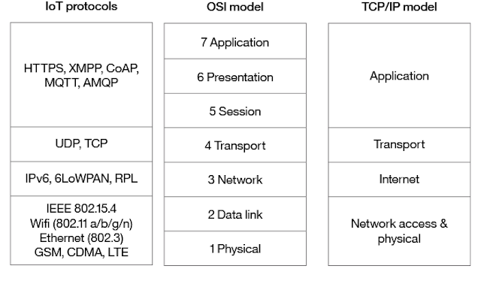
Five Pillars of IT Industry Contd …
Operating Systems
Internet Of Things: Data collected by devices ( Database )
+
Networking
Networking
Database
Programming
Artificial Intelligence

Slide 6
Five Pillars of IT Industry Contd …
Operating Systems
OS : Windows , Linux, Mac ,
Android, iOS
Networking
Database
Programming
Artificial Intelligence

Slide 7
Learning Technique :
https://www.youtube.com/watch?v=ZVO8Wt_PCgE&list=WL&index=98&t=589s
20 %
80 %
Output
Input
Reflect
Implement
Share

Slide 8


